Slide 1
CS 540 Network Architecture
Lecture 7: Congestion Avoidance at the Router
Prof. Younghee Lee
Some part of this teaching materials are prepared referencing the lecture note made by F. Kurose and Keith W. Ross

Slide 2
Congestion avoidance
Motivation
Drops are the only widely used indicator of congestion
TCP - drops and retransmissions
End node involvement for network congestion problem
Why no network level involvement?(ECN, reservation? Inter-router collaboration?)
Buffer size
Space for bursts of packets
Latency
Congestion Collapse
Congestion Avoidance
Load
Load
Kbytes/sec
Kbytes/sec
Goodput
Goodput
Time
Time

Slide 3
FIFO + Drop-tail Problems
Surge of congestion in TCP: slow start etc.,
Retransmission adding to the load on the network
Global synchronization: end hosts react to same events
Full queues
no room for bursts of packets => problem to bursty traffic
Remind: Buffer size => Space for bursts of packets
Routers are forced to have large queues to maintain high utilizations => High latency ( bigger buffer -> bigger delay)
TCP detects congestion from loss:
Forces network to have long standing queues in steady-state
Congestion avoidance without loss detection? Yes. How?

Slide 4
FIFO + Drop-tail Problems
Lock-out phenomena:
Some end hosts react to same events → Traffic gets synchronized easily → allows a few flows to monopolize the queue space: → Lock-out other flows
Fairness problem
Does not separate between different flows
Susceptible to misbehaving flows.
No policing: send more packets → get more service

Slide 5
Random Early Detection(RED)
Active Queue management
Motivation
Surge of congestion in TCP: slow start etc.,
Router centric congestion avoidance:
Router does something for network layer problem
“EPD” in TCP over ATM
Keep the average queue size small in routers
bigger buffer -> bigger delay
in case of self-similar traffic (more bursts)
RED
Proactive: packet discard before full queue (drop-tail: reactive)
In the context of ISA, RED can be exercised on queues for elastic traffic.
Inelastic traffic: reservation

Slide 6
RED Design Goal
Congestion Avoidance
detect the onset of congestion to maintain the network in a region of low delay and high throughput
Global synchronization avoidance
implicit notification by dropping packets to as many connections as necessary
Avoidance of bias against bursty traffic
Maintain shorter queues to accommodate bursts
Bound on average queue length
control the average queue size and therefore average delay
Queue size should reflect ability to accept bursts rather than steady-state queuing
Fairness in drops (proportional)

Slide 7
Design
Solution of Lock-out Problem?
Random drop
Packet arriving when queue is full causes some random packet to be dropped
Drop front
On full queue, drop packet at head of queue
Random drop and drop front solve the lock-out problem but not the full-queues problem
Solution of Full Queues Problem?
Drop packets before queue becomes full (early drop)
Intuition: notify senders of incipient congestion
Avoid window synchronization
Randomly mark packets
Avoid bias against bursty traffic: shorter queue
Some protection against ill-behaved users

Slide 8
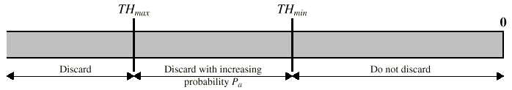
RED Algorithm
Calculating average queue size
exponentially weighted average of previous queue length
to filter out transient congestion at the router
avg = (1-w_{q})avg + w_{q}q;
small value of weight is w_{q} recommended: w_{q} =0.002
large weight value? : sensitive to transient congestion
Determining packet discard
The closer avg is to TH_{max}, the higher the probability of discard (*1)
As long as avg is in the critical range
keep a count of how many consecutive packets escape discard (*2)
the higher the value of count, the higher the probability of discard

Slide 9
RED Algorithm
(*1)
(*2)

Slide 10
RED Algorithm
Upper bound on w_{q} depends on min_{th}
Want to ignore transient congestion
Can calculate the queue average if a burst arrives
Set w_{q} such that certain burst size does not exceed min_{th} Why?
Lower bound on w_{q} to detect congestion relatively quickly. Why?
Typical w_{q} = 0.002
min_{th} determined by the utilization requirement
Tradeoff between queuing delay and utilization
Higher min_{th} => higher utilization, longer queuing delay
Relationship between max_{th} and min_{th}
Depends on average queue increase in one RTT
Paper suggest ratio of 2
Current rule of thumb is factor of 3

Slide 11
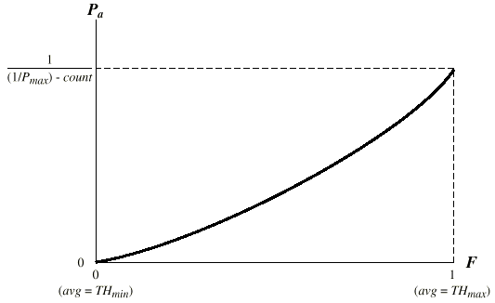
RED Algorithm
Queues aren’t full
Bursts are accommodated
Lower latency
Smarter drops
better feedback
more evenly distributed

Slide 12
Extending RED for Flow Isolation
Problem: what to do with non-cooperative flows?
Fair queuing achieves isolation using per-flow state – expensive at backbone routers
How can we isolate unresponsive flows without per-flow state?
RED penalty box
Monitor history for packet drops, identify flows that use disproportionate bandwidth
Isolate and punish those flows

Slide 13
Explicit Congestion Notification(ECN)
The goal is to provide explicit congestion notification to senders.
Complements the implicit feedback through packet drops
Bits 6-7 of the TOS bit form the ECN field.
The ECN-Capable Transport (ECT) bit is set by the sender to indicate that the end-points are ECN-capable
The Congestion Experience (CE) bit is set by the router to signal congestion
The ECN is received by the receiver, who is responsible for forwarding the information to the sender.
End nodes(L4)<->network(L3): problems?
V/HL
TOS
Length
ID
Flags/Offset
TTL
Prot.
H. Checksum
Source IP address
Destination IP address
Options..

Slide 14
Use of ECN with TCP
Receiver signals congestion to the sender by setting the ECN-Echo flag in the TCP header.
Bit 9 in the reserved field of the TCP header
Deals correctly with asymmetric routes
ECN-Echo flag also used to negotiate ECN use
The TCP sender should respond to ECN feedback as if a single packet loss occurred.
Reduce the congestion window size
ECN and RED are supposed to leverage each other.
The router should set the CE bit if it would otherwise have dropped the packet (for a non-ECN enabled flow)
When RED is used, this happens before the queues fill up so ECN and RED combined can result in congestion notification without packet loss

Slide 15
Random Exponential Marking (REM)
Periodically updates a congestion measure called “price”
Price p(t)
used to determine the marking probability
Rate mismatch: i.e., difference between input rate and link capacity
Queue mismatch: i.e., difference between queue length and target value
incremented if the weighted sum of these mismatches is positive, and decremented otherwise.
pl(t + 1) = [pl (t) + γ(αl(bl (t) – b*l) + xl(t) – cl(t))]+,
where γ > 0 and αl > are small constants. and [z]+ = max {z, 0}.
bl(t) is the aggregate buffer occupancy at queue l in period t and b*l ≥ 0 is target queue length,
xl(t) is the aggregate input rate to queue l in period t, and cl(t) is the available bandwidth to queue l in period t.
The constant α l can be set by each queue individually, and trades off utilization and queuing delay during transient.
The constant γ controls the responsiveness of REM to changes in network conditions.
In equilibrium the price stabilizes, and this weighted sum must be zero. ➔ This can hold only if the input rate equals capacity (xl = cl) and the backlog equals its target (bl = b*l )

Slide 16


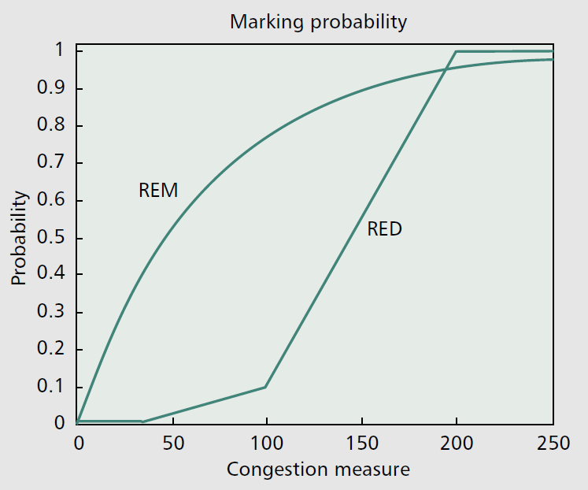
Random Exponential Marking (REM)
Marking probability
suppose a packet traverses links l = 1, 2, …, L that have prices pl(t) in period t. Then the marking probability ml(t) at queue l in period t is
where φ > 1 is a constant.
The end-to-end marking probability for the packet is then

Slide 17
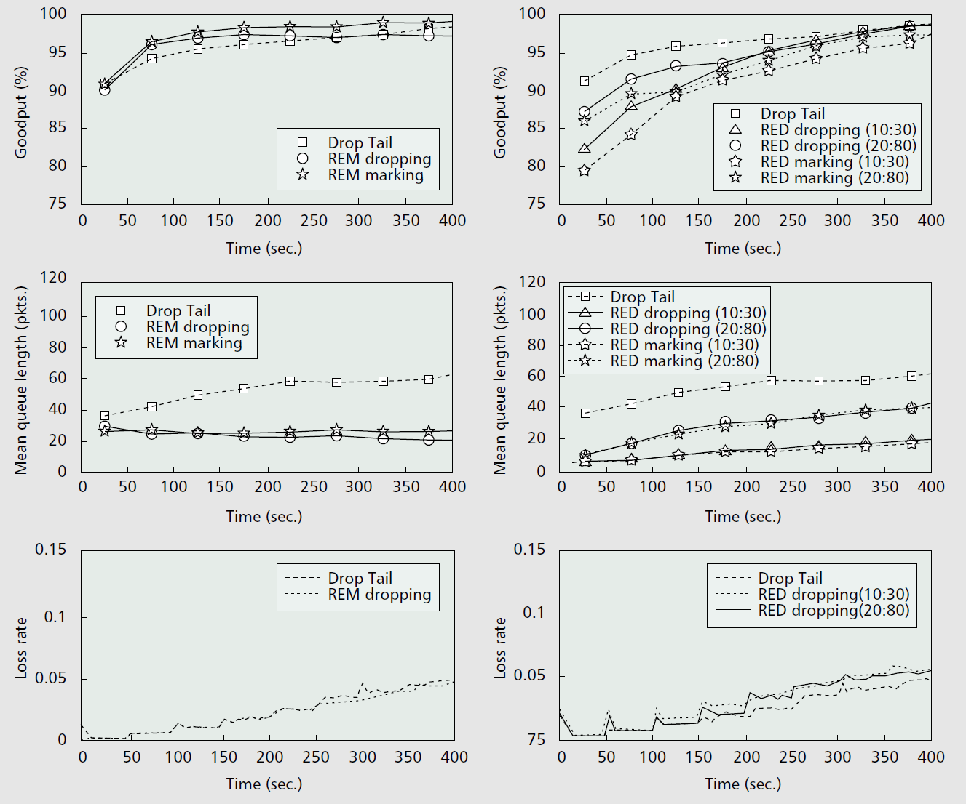
Random Exponential Marking (REM)
Performance of NewReno/DropTail, NewReno/RED, NewReno/REM.

Slide 18
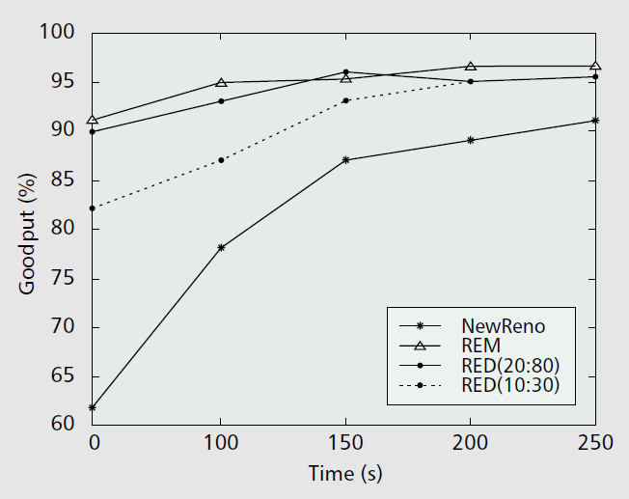
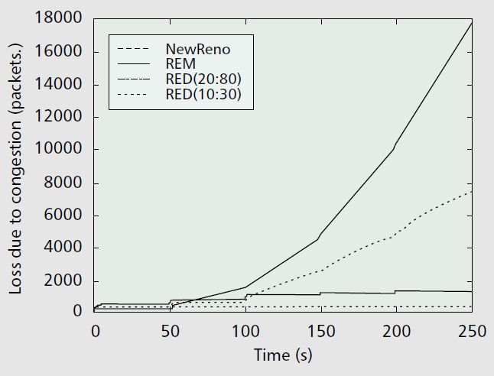
Random Exponential Marking (REM)
Performance of Wireless TCP
As time increases on the x-axis, the number of sources increases from 20 to 100 and the average window size decreases from 22 to 4 packets.

Slide 19
Flow (Fair) Random Early Drop (FRED)
Review of RED
Non-Adaptive traffic: udp based MM traffic
Non-responsive to implicit congestion
Danger of domination
Adaptive(TCP) & Robust traffic
Always has data to send: larger windows and shorter RTT values
Non-proportional dropping among identical flows
RED: can pick the same connection to drop packets for a short period of time
Accepting a packet from a connection cause higher drop prob. for future packets from other connection
Adaptive & Fragile traffic
More sensitive to loss: smaller windows and/or longer RTT
Bias against fragile connections
RED: uniform loss rate regardless of the resource usage ➔ Not guarantee fair bandwidth sharing

Slide 20
FRED design goal
Flow Database
+
f₁
f₂
f₃
...
f_{N}
–
3
1
3
...
1
Strikes
Classifier
Network
Interface
Maintain a single FIFO queue but track the number of packets in the queue from each connection
Drop packets from a connection when the connection exceeds its share of the queue’s capacity
Drops are proportional to bandwidth used
Unresponsive flows are identified and penalized
Notes:
Goals
Extend RED
Better Fairness
Fairness concerns here were still TCP-based; concerned about applications like Telnet (fragile, always in slowstart; constantly having to time-out because of no opportunity repeated ACKs.)
dynamically calculated per flow thresholds based on share of queue (red-like thresholds)
threshold equal to a multiple of the “fair share” to accommodate bursts
strikes further restrict the share of the queue and prevent you from abusing “fair share”

Slide 21
FRED
Maintain per flow state only for active flows (ones having packets in the buffer)
min_{q} and max_{q} → min and max number of buffers a flow is allowed occupy
avgcq = average buffers per flow
Strike count of number of times flow has exceeded max_{q}
Non-adaptive flows
Flows with high strike count are not allowed more than avgcq buffers
Allows adaptive flows to occasionally burst to max_{q} but repeated attempts incur penalty

Slide 22
FRED design goal
Goal: Reduce unfairness of RED
Parameters
w_{q}= 0.002;
minth = MIN(buffer size / 4, RTT);
maxth = 2*minth;
maxp = 0.02;
Additional parameters
avgcq: estimate for average per-flow buffer count;
maxq: maximum # of packets allowed per-flow buffer count;
minq = minimum # of packets allowed per-flow buffer count;
2 for small buffers, 4 for large buffers;
Per-flow
qleni: number of packets buffered;
strikei: number of over-runs;

Slide 23
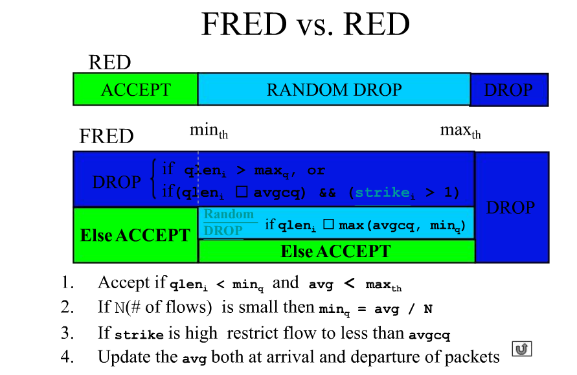
FRED design goal
From slides of author

Slide 24
TCP Performance with FRED
1,400
UDP blast
1,200
1,000
FIFO
RED
FRED
800
TCP Throughput
(Kbytes/Sec)
600
400
200
0
0
10
20
30
40
50
60
70
80
90
100
Time (seconds)

Slide 25
Discussion: picked up randomly
According to observations of proposed mechanism in this paper; how we can determine the optimum average queue size using RED gateway? It is very difficult to determine the optimum average queue size for maximizing throughput and minimizing delay. If the source rate increased then, how we can control the length of growing queue? And how we can control the rate of marked packets in network? If the number of users increases then, how we can control the queues length?
It is observed that REM has similar properties as PI controller has; it is well known that PI cannot efficiently detect the congestion. So, it is not clearly elaborated that how REM can target this issue in paper. The other few questions still need to be address: how REM can achieve fast convergence speed when providing large information? What about REM responses when dynamic traffic within networks? Finally, we need to address these shortcomings of REM algorithm.

Slide 26
Discussion
In the paper, Fig 2 shows that conventional REM is no better than Drop tail, it seems that it conflicts with the two previous papers. What factors caused these results?
As authors wrote, this approach has a problem with its application in ECN-capability. Is this active queue management approach scalable in practice? If then, how much proportion does it takes currently?
While we could detect congestion with RED gateways, can we detect which connection(s) creates congestion. As a result, we could find out a way to reduce traffic come from this connection and give bandwidth to others?
When RED gateways detect congestion, they will either drop packets or mark congestion bit in packets’ headers. While dropping packets could help to control average queue size, is there any case that dropping packets is a bad thing to do and mark congestion bit is a better way to use?

Slide 27
Discussion
This is enhanced by the third paper’s presented technology, FRED - that takes into account the bandwidth taken by each flow to balance both between sender nodes and by bandwidth occupied.
One advantage that the paper presents is that FRED is “more effective at isolating ill-behaved flows”. This could also be valid for voluntarily ill-behaved flows: for example, if an infected device (such as an IoT device) tries a TCP SYN flood, it will try to use as much bandwidth as possible. The usage of FRED in ISP or enterprise routers will limit the unwanted traffic.
REM: This process, however, can only be useful if end nodes behave correctly. We could imagine, for example, TCP implementations that would refuse to go back to Slow Start if they suspect that the packet loss was to force a Slow Start. The paper suggests to count every marker sent to every node, to detect incorrect behaviour. In the case of disobedience, the router could limit or block input from this node.
Studying these processes might lead us to think that these processes do not distinguish users (or flows, in the case of FRED) from each other. We might for example, as administrators, want to favor bandwidth for a particular user. In that case, we could add a system of coefficients depending on the user in the probability/price equation.

Slide 28
Reading Assignment
Jon C.R. Bennett, “WF2Q : Worst-case Fair Weighted Fair Queueing”
Ion Stoica et al., “Core-St at eless Fair Queueing: Achieving Approximately Fair Bandwidth Allocations in High Speed Networks*”
Submit less than 1 page report online via KLMS by 6pm Oct. 3 which is the day before the lecture of Oct. 4 (Tue.)
Submit also hard copy report at the beginning of the lecture of Oct. 4 (Tue.) as attendance check and for discussion

